Slide 1
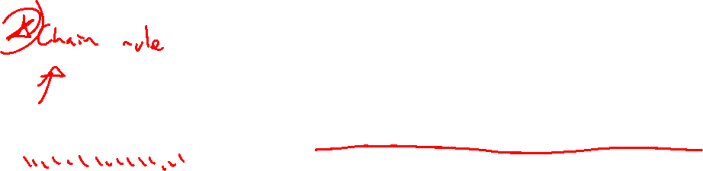
Section 10.2 Calculus with Parametric Curves
Lecture 1
Extending calculus, derivatives and areas

Slide 2

Homework Submission to Canvas
Preview of section
Skim the section in text and write a short paragraph summary.
Give a bulleted list of all important definitions, theorems, and formulas without details.
Notes on video lectures
Take notes on everything written on slides including all details, worked examples, on-own activities, as well as your own thoughts and questions.
Try on-own activities first, then write down provided solution next to it for comparison.
Worked examples from the text
Write down the problem and attempt without looking at the solution.
Use the solution to write the best explanation you can.
Solutions to textbook exercises
Model approaches and explanations given in the video lectures and textbook examples.
Final reflection of section
List the key takeaways to remember as a bulleted list.

Slide 3
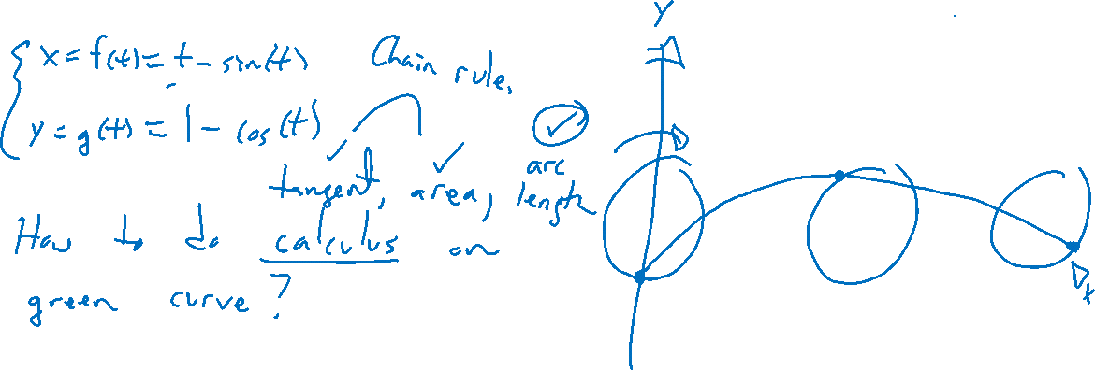
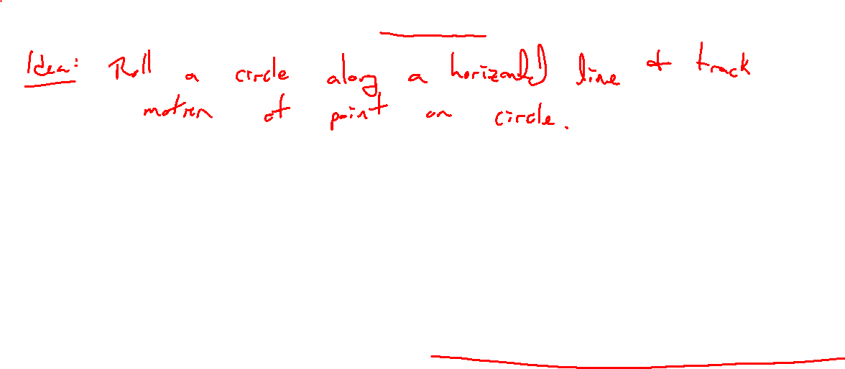
Motivating Example: Cycloid
Notes:
X(t) = t-\sin(t)
Y(t)=1-cos(t)
Desmos, draw graph. Point out looks like regular function, all fair play.

Slide 4
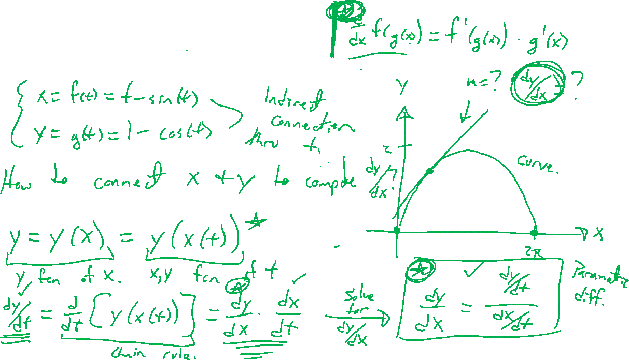
Derivative via Chain Rule
Notes:
Chain rule is all we need. Remember y=y(t), but if the curve is a function (at least locally), we have that y=y(x)=y(x(t)).
Then, dy/dt = dy/dx dx/dt giving dy/dx = (dy/dt)/(dx/dt).
Second (and higher order) derivative is now easy.

Slide 5
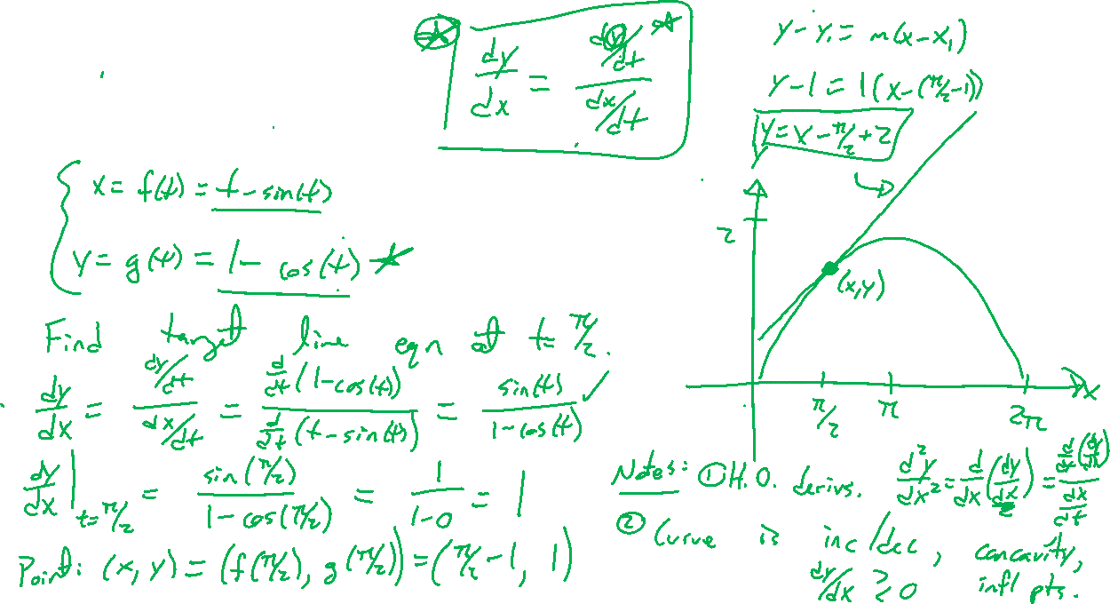
Example: Cycloid
Notes:
Find tangent line when t=\pi/2, find horiz / vert tangent lines. Run thru Desmos.
Verify always concave down.

Slide 6
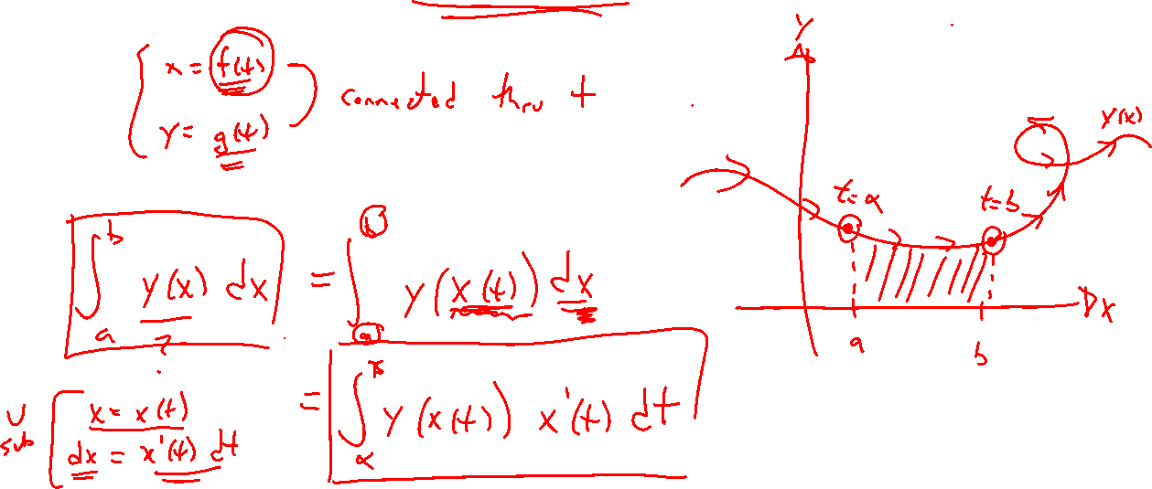
Integration via Substitution
Notes:
Again, need y=y(x) a function locally on [a,b]. Substitute x=x(t) with \alpha < t < \beta then
\int_a^b y(x)~dx = \int_{\alpha}^{\beta} y(x(t)) x'(t) dt

Slide 7
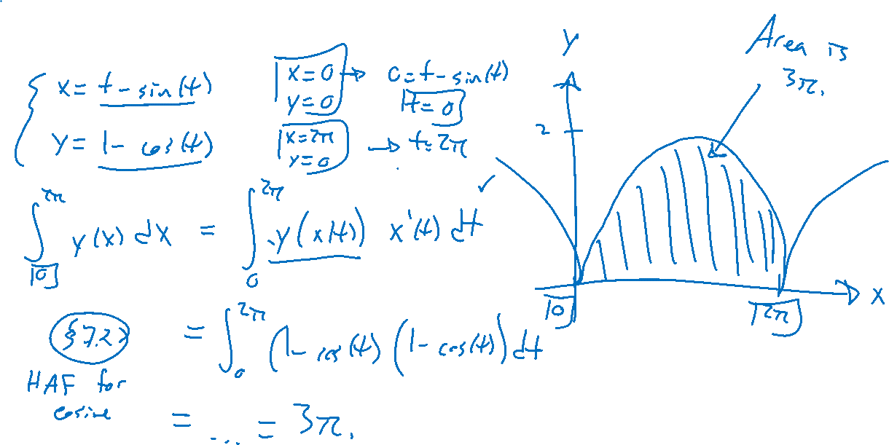
Example: Cycloid
Notes:
Find the area of one bump.
\int_0^{2\pi} y(x) ~dx = \int_0^{2\pi} y(t) x'(t)~dt = …= 3\pi
Need half angle formula for cosine.

Slide 8
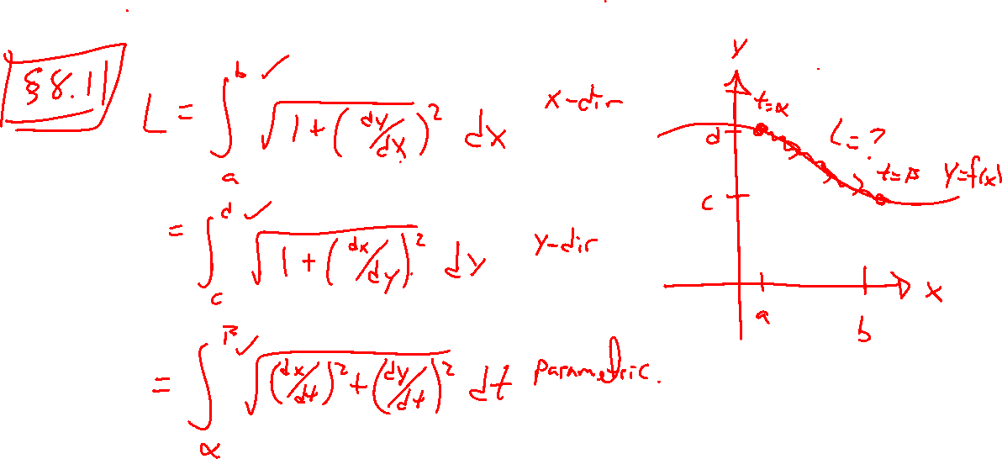
Flash from the Past: Arc Length
Notes:
Recall arc length formulas. Choose parametric version.

Slide 9
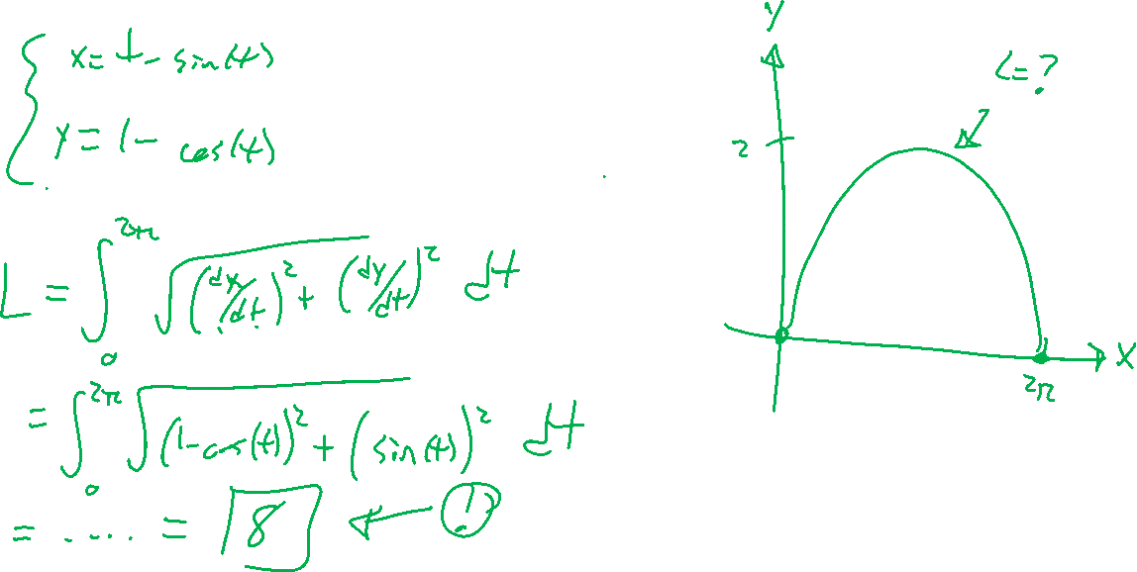
Example: Cycloid
Notes:
Verify the length of one bump is 8. For any cycloid of circle of radius r, get 8r instead.

Slide 10
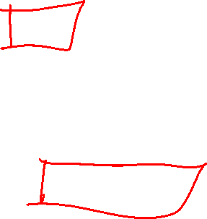
Section 10.2: Textbook Examples and Exercises
Rework examples 1, 4 in the text. Steps:
Write down a problem.
Close the book and attempt on own.
Check / correct your solution against the text solution.
If needed, rewrite the problem to be of the quality of the text solution.
Complete exercises: 5, 11, 37, 41
Write solutions of the same quality as in lecture and text solutions.
Check your solution against the answer in the back of the book.

Slide 11

Homework Submission to Canvas
Preview of section
Skim the section in text and write a short paragraph summary.
Give a bulleted list of all important definitions, theorems, and formulas without details.
Notes on video lectures
Take notes on everything written on slides including all details, worked examples, on-own activities, as well as your own thoughts and questions.
Try on-own activities first, then write down provided solution next to it for comparison.
Worked examples from the text
Write down the problem and attempt without looking at the solution.
Use the solution to write the best explanation you can.
Solutions to textbook exercises
Model approaches and explanations given in the video lectures and textbook examples.
Final reflection of section
List the key takeaways to remember as a bulleted list.

